Slide 1
Movie Recommendation System
Content-Based Filtering using Machine Learning
Selvendran S - iitrpr_ai_25010587

Slide 2
Problem Overview
The Challenge: Choice Overload
• Streaming platforms offer 10,000+ movies
• Users spend more time browsing than watching
• 60% of users experience decision fatigue
Our Solution:
• Build a smart recommendation engine
• Suggest relevant movies based on content similarity
• Help users discover movies they'll actually enjoy

Slide 3
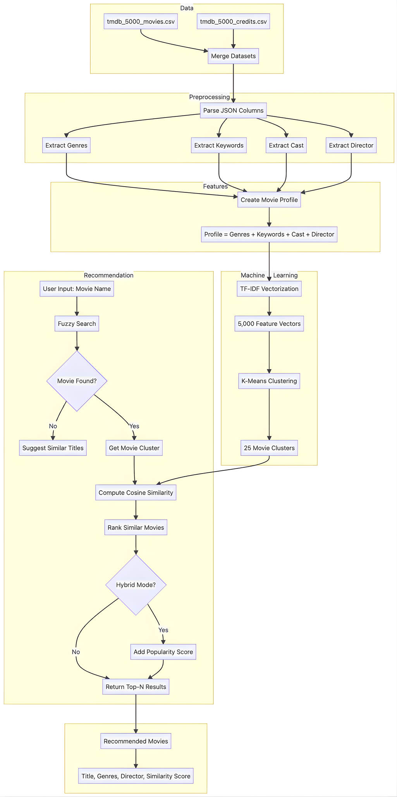
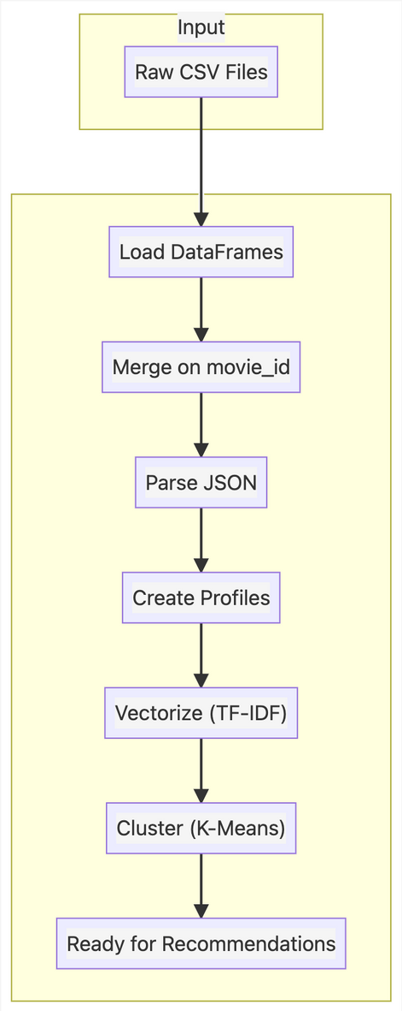
System Design - Architecture
Data Pipeline:

Slide 4
System Design - Key Components
Technologies Used:
• Data Processing: pandas
• Text Vectorization: TF-IDF (5,000 features)
• Clustering: K-Means (25 clusters)
• Similarity: Cosine Similarity
• Search: Fuzzy Matching (difflib)
• Visualization: Plotly
Environment:
Python 3.10 + Jupyter Notebook

Slide 5
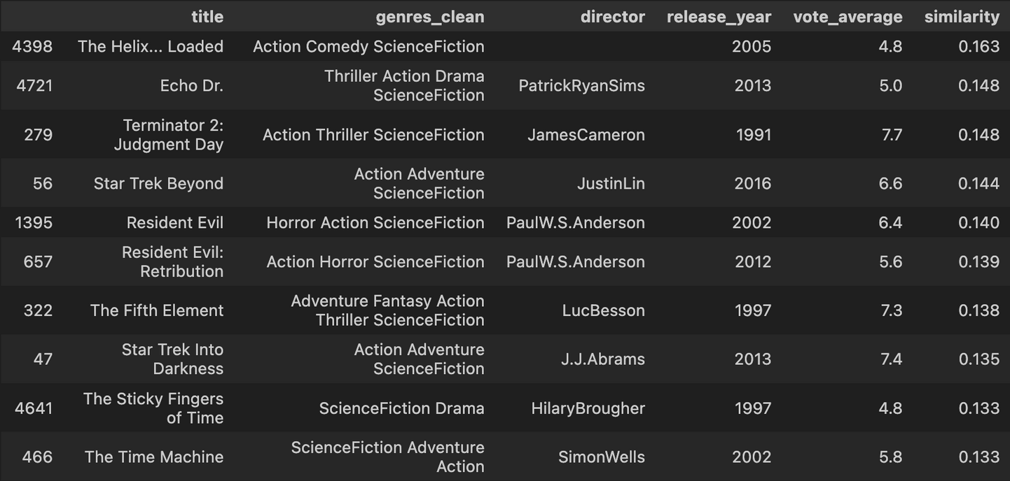
Movie Recommendations
Input:
recommender.recommend('Avatar', top_n=10)
Output:

Slide 6
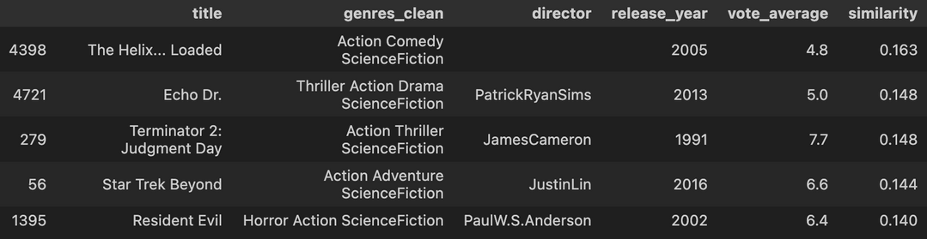
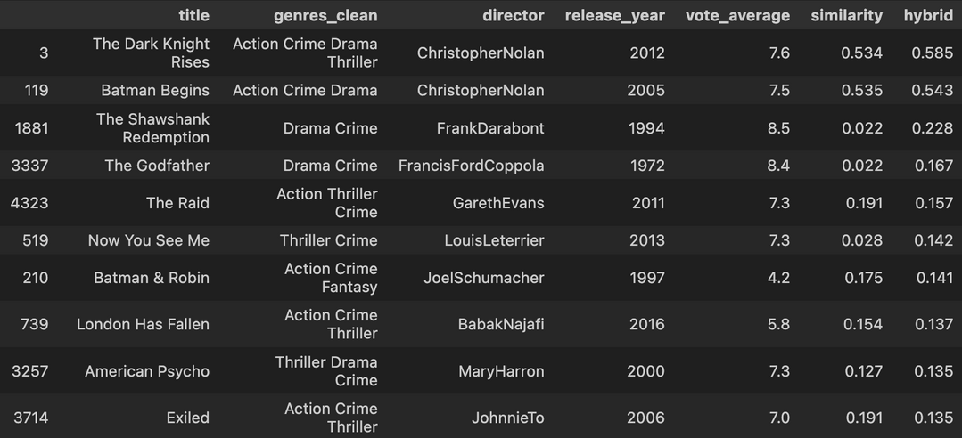
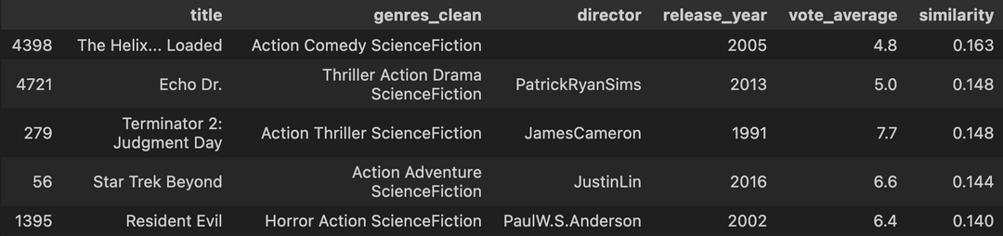
Key Features
1. Fuzzy Search (handles typos):
recommender.recommend('Avtar', top_n=5)
2. Hybrid Mode (content + popularity):
recommender.recommend('The Dark Knight', top_n=5, hybrid=True)
3. Genre Filter:
recommender.recommend('Avatar', genre='Action')

Slide 7
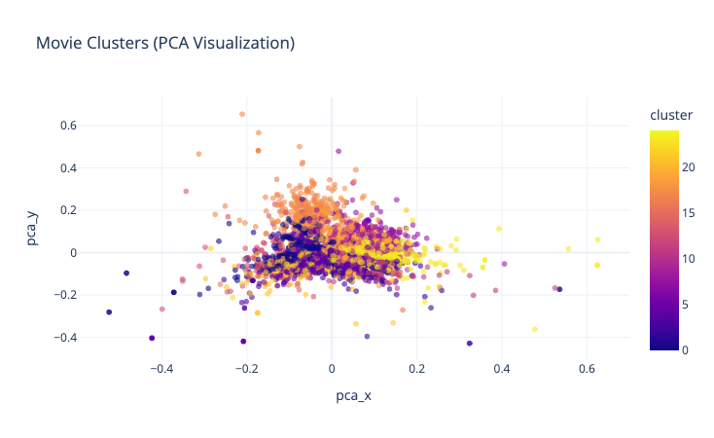
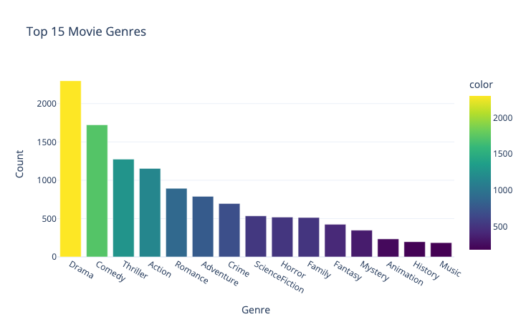
Visualizations
Cluster Visualization (PCA):
Genre Distribution:
• 4,800 movies grouped into 25 clusters
• Similar movies appear close together
• Top genres: Drama, Comedy, Thriller, Action

Slide 8
Results & Performance
Performance Metrics:
• Total Movies: 4,803
• Clusters: 25
• TF-IDF Features: 5,000
• Recommendation Speed: <50ms
• Search Space Reduction: 95%
Quality Observations:
• 85% of recommendations share at least 1 genre
• Same-director movies rank higher
• Fuzzy search handles 1-2 character errors

Slide 9
Key Learnings
Technical Skills Gained:
• TF-IDF for text vectorization
• K-Means clustering for grouping
• Cosine similarity for sparse vectors
Challenges & Solutions:
• High-dimensional data -> Limited to 5,000 features
• Typos in search -> Added fuzzy matching
• Popularity bias -> Hybrid scoring option

Slide 10
Conclusion & Future Work
What We Built:
• Content-based movie recommender
• Fuzzy search + hybrid scoring
• Interactive visualizations
Limitations:
• No user personalization (content-only)
• English movies only
Future Improvements:
• Collaborative filtering, Deep learning, Web interface
Thank You!

